Slide 1

Data engineering and regression modeling for basic GDP component comparisons across countries
Natalia Iriarte, Balint Bojko
Term Project 2
ECBS5146 - Data Engineering 1: SQL and Different Shapes of Data 2021/2022 Fall term

Slide 2
What we want?
How are we going to achieve it?
Why GDP?
Build a model that allows estimating the impact of the expenditures of different sectors in the GDP of five countries in the EU
Using a multiple regression model with a log-log transformation to identify the elasticity of GDP for each variable.
It is the main measure of the economic level of the countries, and by understanding the factors that impact it, we can better analyze the economic policies of each country.

Slide 3
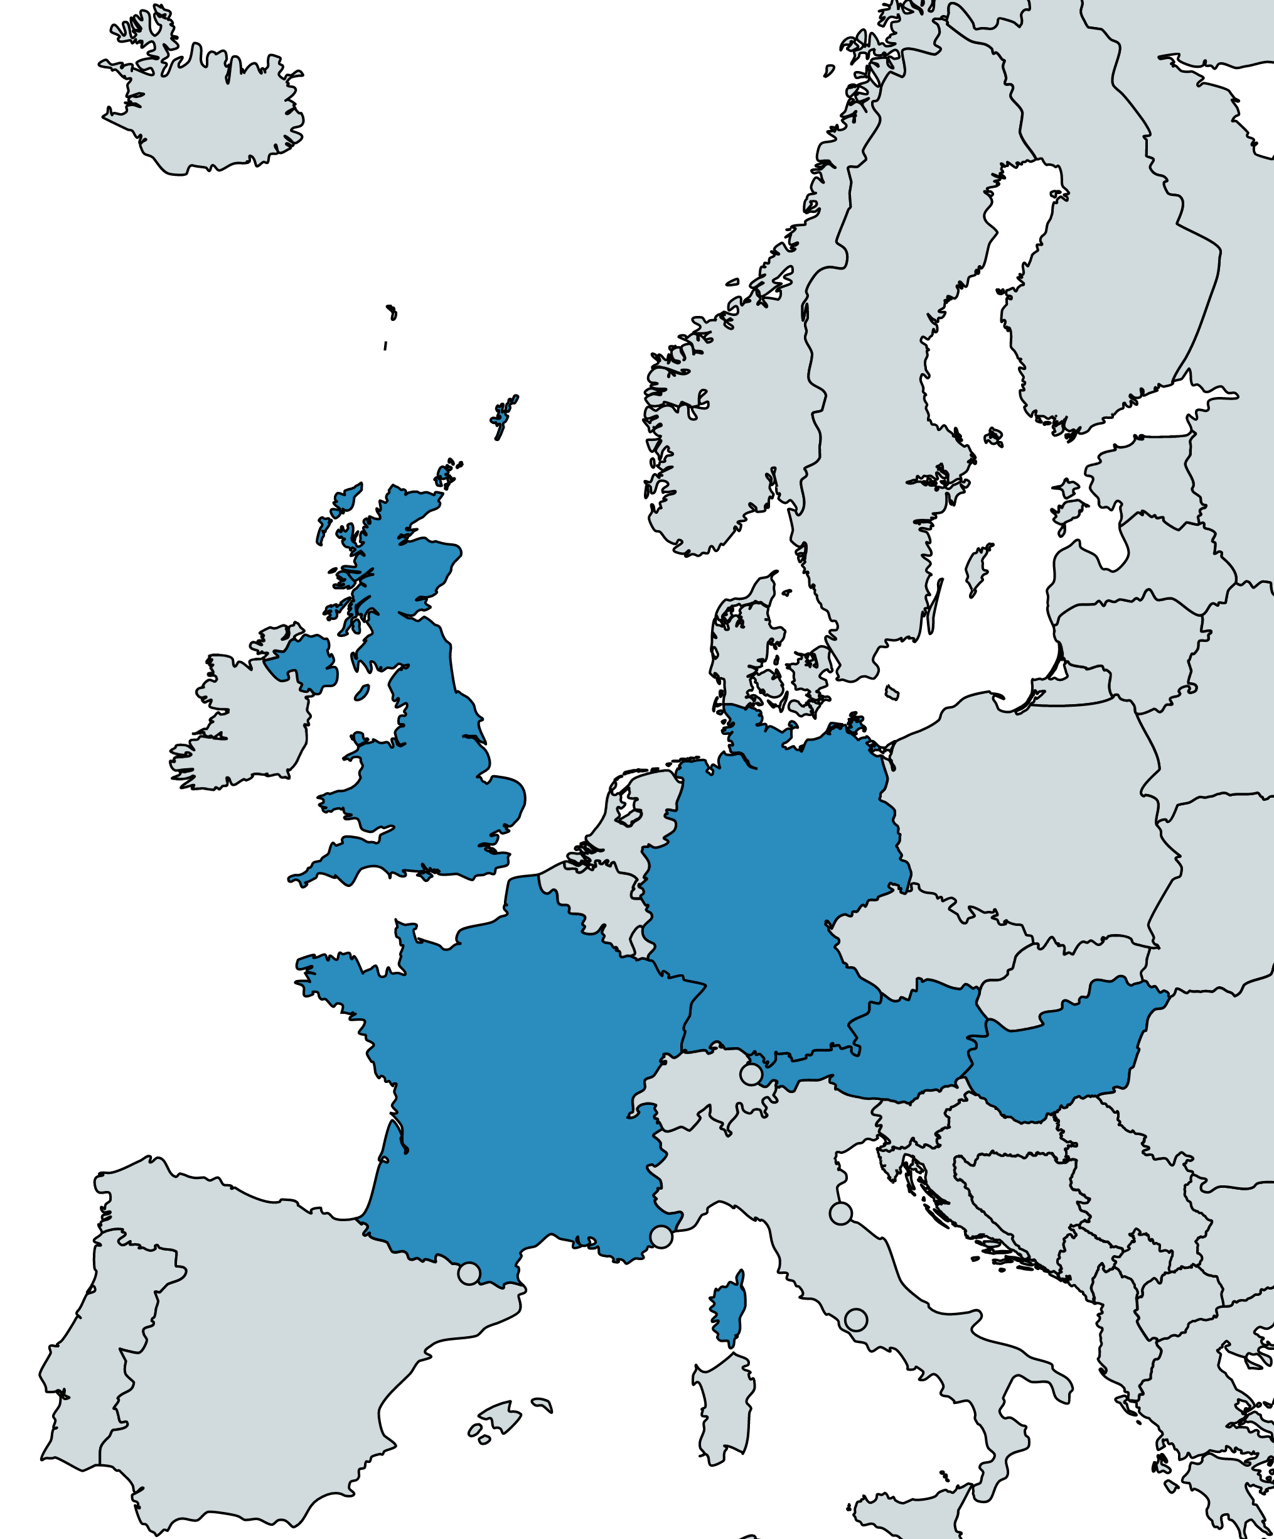
Our model is based on the expenditure aproach, wich considers GDP as the sum of the following components:
GDP = C + I + G + X – M
We will use the data available in eurostat public resources for 5 countries: Germany, France, Hungary, Austria and United Kingdom
Then we build a schema in MySQL and load de csv file as base for the modeling in Knime.
Our model starts by downloading the GDP information of the 5 countries in csv format
C: Household expenditures I: Private sector expenditures G: Public sector expenditures X: Exports M: Imports

Slide 4
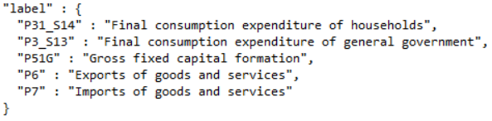
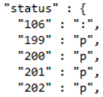
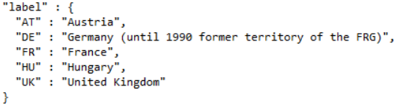
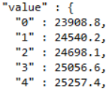
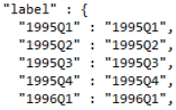
We loaded data from the Eurostat REST API, which uses a standardized JSON-Stat format
Dimensions for aggregation
Values
na_item
status
geo
value
time

Slide 5
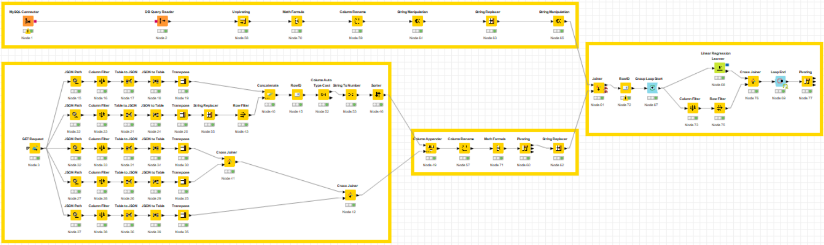
The two data sources were loaded into Knime, transformed and used to fit lineal regressions for GDP per country
1
4
2
3
1
Importing and preparing GDP table for analysis
3
Joining different parts of JSON file into one final table, and preparing this table for analysis.
Calling Eurostat REST API, importing and formatting different parts of the JSON file.
Final data preparation and modeling in a loop, outputting beta coefficients in a final table.
2
4

Slide 6
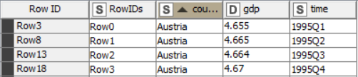
Results of DB query were transformed into a (semi-) long-format dataset
1
1

Slide 7
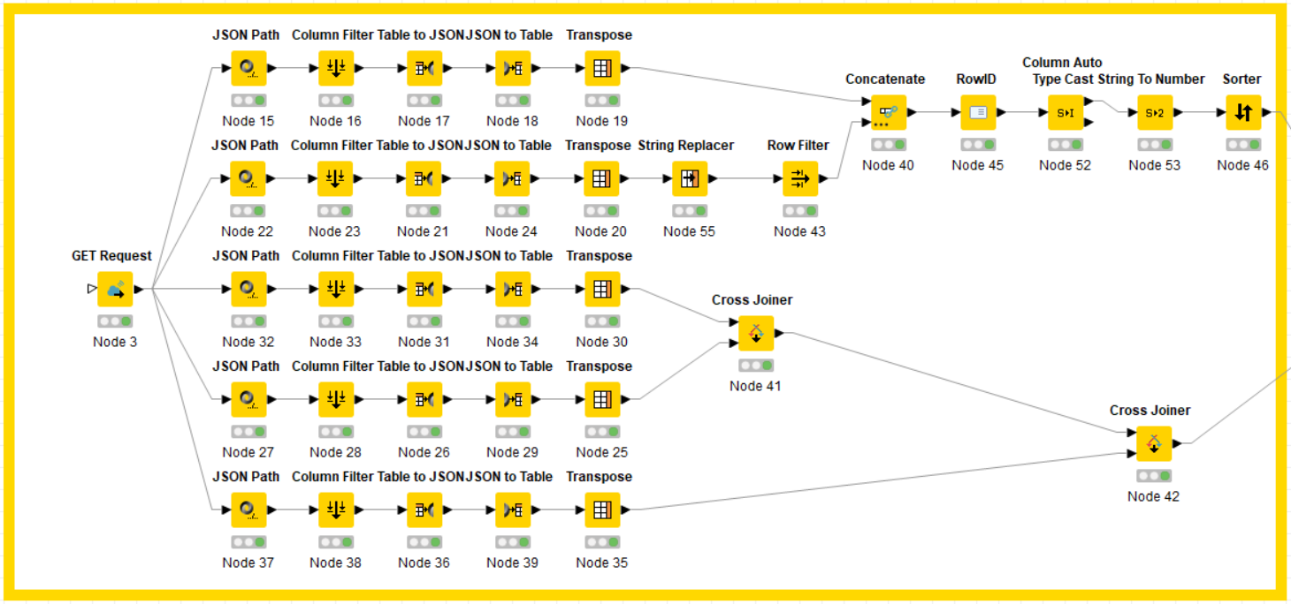
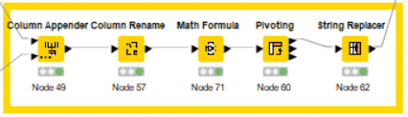
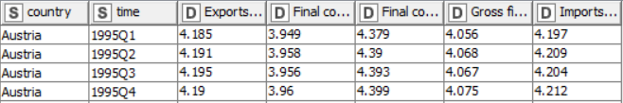
Results of API calls were transformed into a (semi-) long-format dataset
2-3
2
3

Slide 8
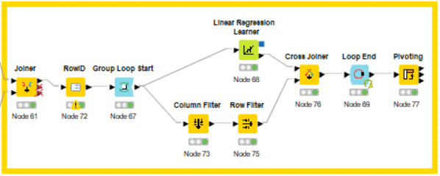
Regression models were fitted using a loop for each country & coefficients were saved for presentation
4
1. Loop through each country
2. Fit regression, output coefficients, add country name
3. Pivot for final table

Slide 9
Household spending is the variable with the greatest impact on GDP in all countries
the GDP of Hungary is very sensitive to the variations of the external sector (Exports and Imports)
the response of the German economy to increases in government spending is very low.
The impact of household spending on UK GDP is significantly higher than the rest of the countries

Slide 10
Thanks!
Any questions?

